Slide 1
Logic Level Transition

Slide 2
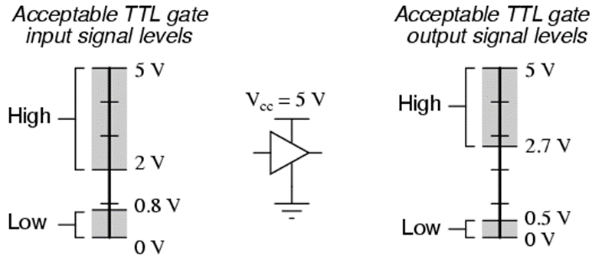
Digital Logic Levels
Most digital logic circuits are in only two states (LOW and HIGH). Zero to 0.7 volts registers as being in the LOW (logic 0) state and 2 to 5 volts registers as being in the HIGH (logic 1) state.

Slide 3
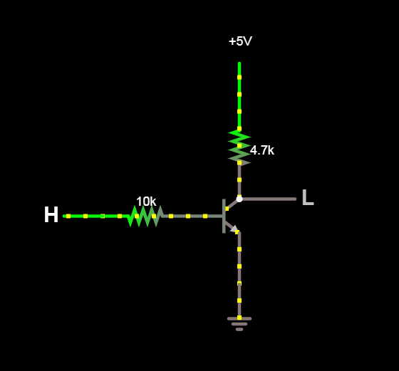
Transistor State Switching
A digital logic level is either HIGH or LOW, or in transition between states.
74LSXX gates have a transition time of about 10 to 15 ns (nanoseconds).

Slide 4
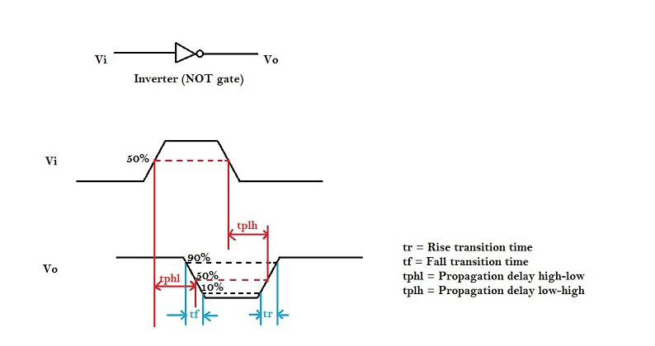
Transition Time & Propagation Delay

